Slide 1
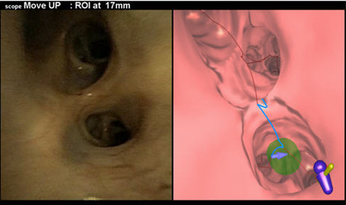
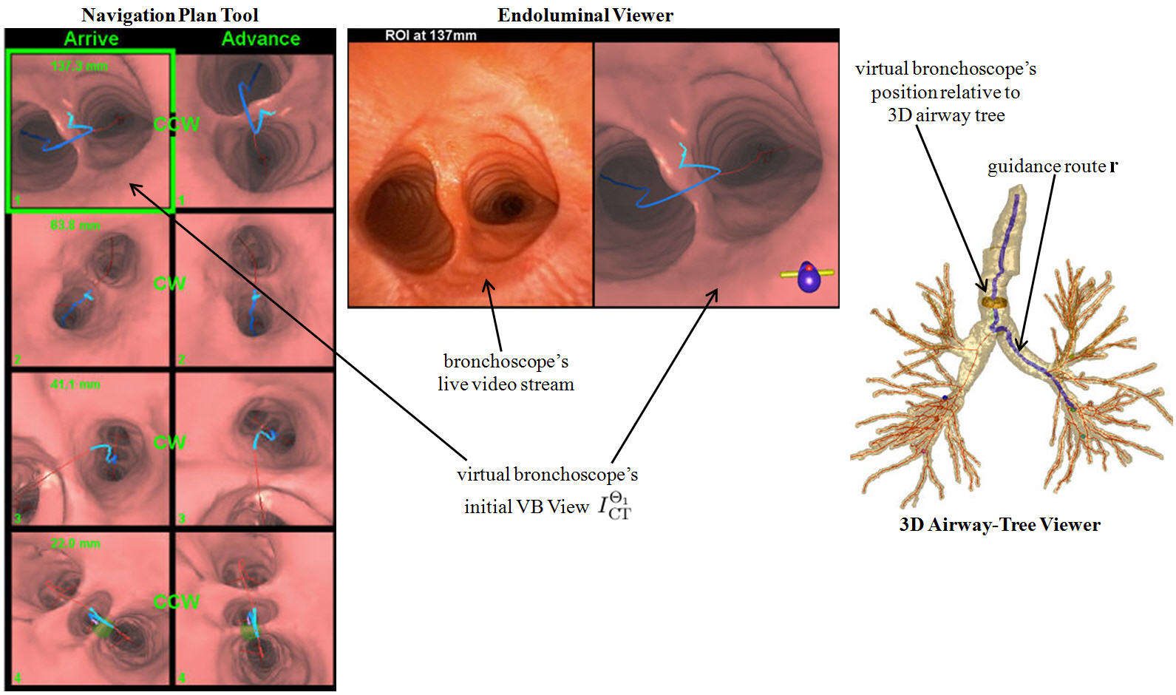
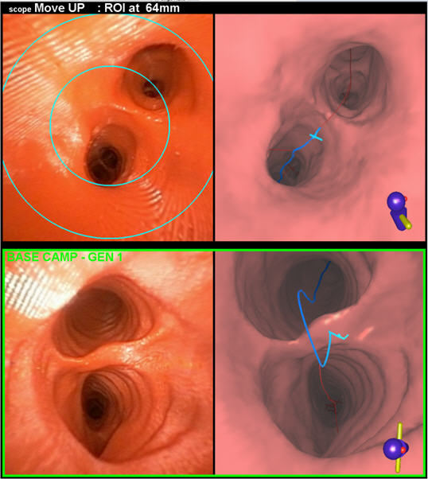
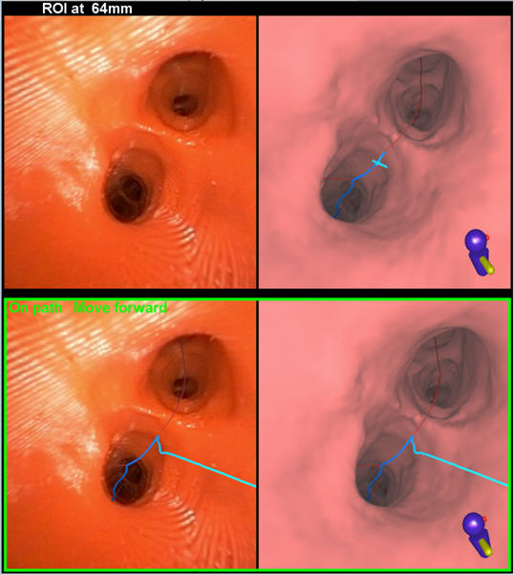
Technician-Free Image-Guided Bronchoscopy System: A Human Study
W. E. Higgins,¹ R. Khare,¹ D. C. Cornish,¹ P.D. Byrnes,¹ R. Cheirsilp,¹ X. Zang,¹ J.W. Toth,² M.F. Reed,² and R. Bascom²
Penn State University, ¹College of Engineering, ²College of Medicine, University Park and Hershey, PA
ATS 2014, San Diego, CA
1. Background
display which saves the previously registered video-VB view pair; and (3) the 3D airway tree depicting navigation progress (Fig. 1). During bronchoscope navigation, the bronchoscopist operates a foot-pedal switch to update the display and get new navigation instructions. For each new displayed maneuver, the bronchoscopist moves the bronchoscope to the suggested position; this registers the bronchoscope’s position to the procedure plan (Fig. 2). During problematic situations (e.g., patient cough), the bronchoscopist can fall back to the previous registered location and resume navigation (Fig. 3).
3. Results and Discussion
The standard unguided approach to navigating the bronchoscope through the airway tree is very challenging, resulting in navigation errors as early as the 2nd – generation airways.¹ While image-guided intervention (IGI) systems have proven to be effective for bronchoscope navigation, they typically require two people to operate: the bronchoscopist and an attending technician.^{2,3,4} This limits the practicality of such systems for more routine use. We had previously demonstrated the potential of a technician-free image-guided bronchoscopy system.⁵ We now present a feasibility study confirming the system’s functionality in a clinical setting.
We consented 9 lung-cancer patients (age: 50-74 years; 2M:7F) and selected 41 total ROIs. We performed technician-free image-guided bronchoscopy for 39 ROIs; we excluded 2 ROIs because the procedure plan revealed that the preselected bronchoscope could not reach them. For the 39 navigable routes, the results are summarized below. We performed successful navigation for 38/39 ROIs (97%), where we defined success as reaching the final ROI location. Fig. 4 shows the final sampling sites for two ROIs.
# of cases | # of lesions | Route Depth (airway generations) | Route Length (mm)
9 | 39 | 4.9 ±1.6 (range: 3-10; median = 4) | 174±29 (range: 124-263; median = 169)
2. Materials and Methods
Live View VB View
The system operates over two stages, as summarized by Figures 1-2.
Stage 1: Procedure planning
The bronchoscopist selects regions of interest (ROIs) on a patient’s chest computed-tomography (CT) scan. Next, automatic methods define a procedure plan, consisting of airway navigation routes leading to each ROI and the three-dimensional (3D) airway tree’s extraluminal and endoluminal surfaces (Fig. 1: 3D Airway-Tree Viewer). Each route bifurcation also has a preplanned bronchoscope maneuver associated with it corresponding to the standard rotate-flex-advance bronchoscope-navigation technique. After these preplanning operations, the bronchoscopist previews the navigation routes and directions on a tablet computer.
(a) System views before [top] and after bronchoscope rotation [bottom] at the main carina
(a) Lesion at right intermediate bronchus
(b) Lesion at left lower lobe bronchus
Figure 4. Figures (a-b) show the Endoluminal Viewer tool at the final sampling site for lesions in two of the cases. (a) lesion in case 20349.3.65 (ROI 2). (b) lesion in case 20349.3.68 (ROI 2).
The mean navigation time of our system compares extremely favorably to previous technician-assisted systems, as tabulated below (mean ± SD).
Approach | Technician-free | Gibbs² | Shinagawa³
Navigation time (min:sec) | 0:51±0:23 | 5:15±5.06 | 8:30±5:42
Airway depth | 4.9 ±1.6 | 7.1 ±2.4 | 5.7 ±1.3
4. Conclusion
(b) System views after advancing guidance view to second branch along currently selected ROI route
The self-guided IGI system has considerable potential for bronchoscope navigation and proved to be safe and feasible in a clinical environment. The technician-free system functioned without adverse events in all cases and enabled markedly faster navigation than current technician-assisted systems.
Figure 2. IGI system views demonstrating the standard rotate-flex-advance maneuver from the main carina to the second branch along the lesion route during live bronchoscopy (20349.3.48). (Figure 1 shows the system setup in preparation for the maneuver.) In (a), the top Endoluminal Viewer tool shows the rotation suggested by the system and the bottom Endoluminal Viewer tool depicts the live bronchoscope view and the virtual view after the bronchoscopist follows the suggested rotation. In (b), the Endoluminal Viewer tool shows the virtual bronchoscope’s view advanced to the next bifurcation along the lesion route. The synchronized virtual and real bronchoscope views from (a) are frozen at the bottom of the tool for the bronchoscopist’s reference. A green rectangle in the Navigation Plan tool and the virtual camera (brown cylinder) in the 3D-Airway Tree viewer present the updated virtual bronchoscope’s position.
Virtual bronchoscopy views
References
Figure 3. Demonstration of position verification. (a) The bronchoscopist invokes the targeting circles and positions the bronchoscope so that the bifurcation lies within the targeting circles. (b) After the bronchoscopist again invokes position verification, the system reports “On path. Move forward” in green lettering in the bottom part of the tool, with the correct path, shown in blue, superimposed on the video frame.
1. M. Y. Dolina, D. C. Cornish, S. A. Merritt, L. Rai, R. Mahraj, W. E. Higgins, and R. Bascom, “Interbronchoscopist
variability in endobronchial path selection: a simulation study,” Chest, April 2008.
2. J. Gibbs, M. W. Graham, R. Bascom, D. Cornish, R. Khare, and W. Higgins, “Optimal procedure planning and guidance
system for peripheral bronchoscopy,” IEEE Trans. Biomed. Engin., March 2014.
3. N. Shinagawa, K. Yamazaki, Y. Onodera, H. Asahina, E. Kikuchi, F. Asano, K. Miyasaka, and M. Nishimura, “Factors
related to diagnostic sensitivity using an ultrathin bronchoscope under CT guidance,” Chest, Feb. 2007.
4. Y. Schwarz, J. Greif, H. D. Becker, A. Ernst, and A. Mehta, “Real-time electromagnetic navigation bronchoscopy to
peripheral lung lesions using overlaid CT images: the first human study,” Chest, April 2006.
5. W.E. Higgins, R. Khare, D.C. Cornish, and R. Bascom, “Physician-Controlled System for Image-Guided Bronchoscopy,” American Thoracic Society, May 2012.
Figure 1. IGI system views during live bronchoscopy (20349.3.48). As labeled above, three visualization tools guide the bronchoscopist during the procedure. The Navigation Plan tool shows pairs of CT-derived virtual bronchoscopy (VB) views at each “viable” bifurcation along the CT-based route plan. The images in the left column depict VB views while approaching the bifurcation (“Arrive”); the VB views on the right present bifurcation views after the bronchoscope is rotated through the suggested rotation maneuver and ready to be advanced (“Advance”). The Endoluminal Viewer tool presents the live bronchoscope video source and current VB view. This tool also saves the previously registered video-VB view pair at the bottom of the tool for the bronchoscopist’s reference (e.g., Figure 2b). The 3D Airway-Tree Viewer shows the global position of the bronchoscope in the airway tree during the navigation process.
Stage 2: Image-guided bronchoscopy
During bronchoscopy for each route, our guidance system displays the following: (1) a summary view of the CT-based route plan, including suggested bronchoscope maneuvers; (2) the live bronchoscope video source and current route location depicted as a CT-derived virtual bronchoscopy (VB) view, plus a
Acknowledgments and Conflict of Interest
This work was funded by NIH NCI grants R01-CA151433, R01-CA074325, and R44-CA091534. Drs. Higgins and Bascom have an identified conflict of interest related to grant R01-CA151433, which is under management by Penn State and has been reported to the NIH.
(a) Endoluminal viewer with targeting circles
(b) Endoluminal viewer with
position verification
Notes:
1
1

