Slide 1
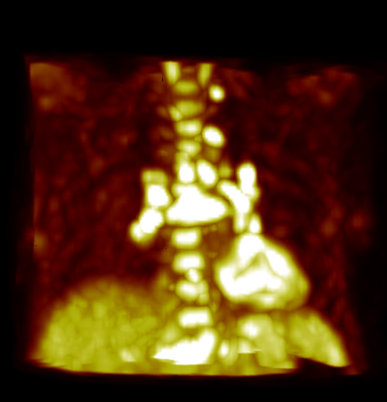
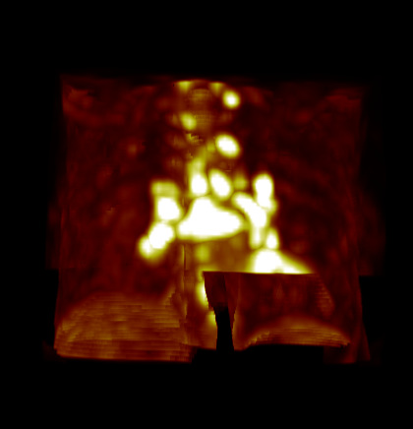
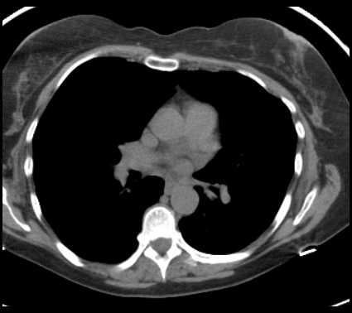
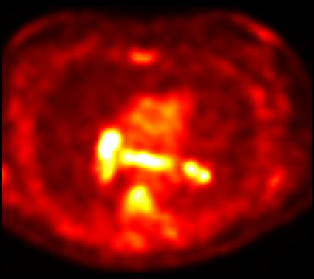
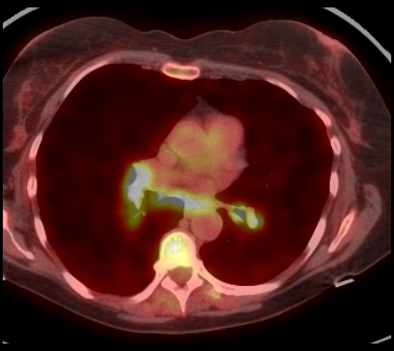
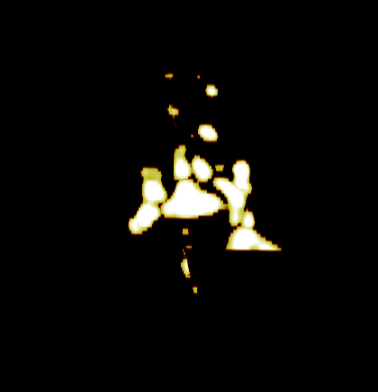
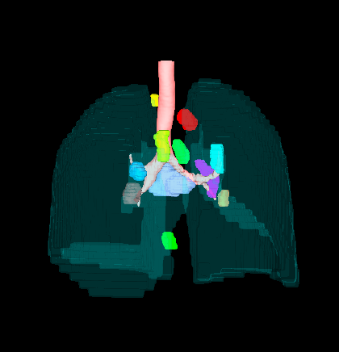
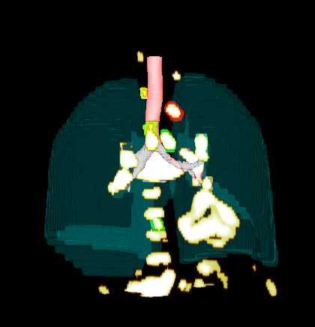
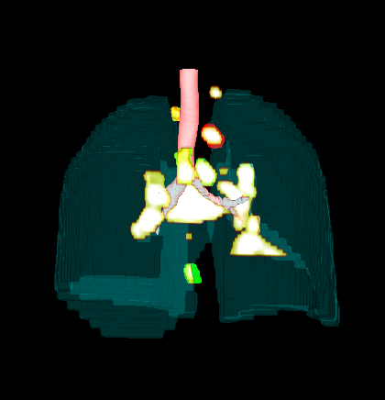
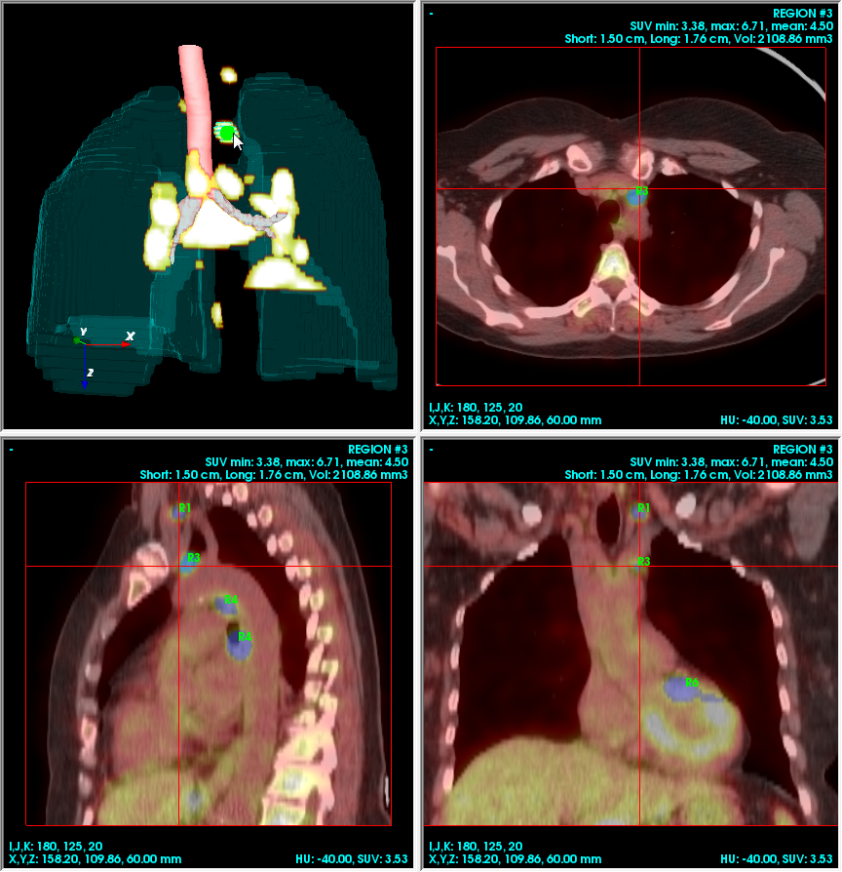
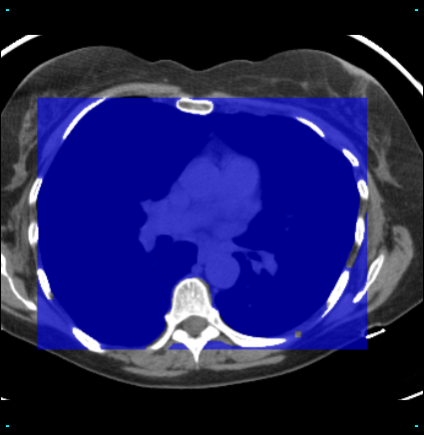
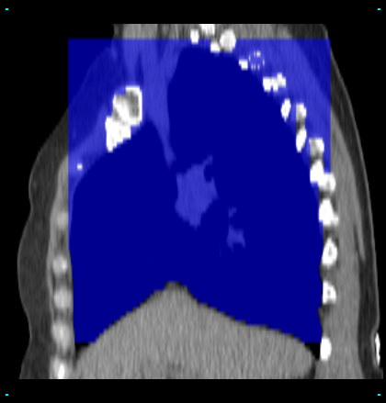
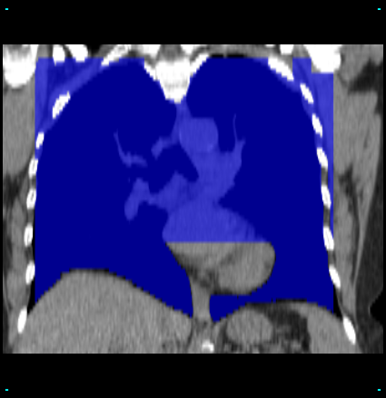
Automated 3D PET/CT-based Detection of Suspect Central-Chest Lesions W.E. Higgins,¹ R. Cheirsilp,¹ R. Bascom,² T. Allen,² A.E. Dimmock,² and T. Kuhlengel ² Penn State University, ¹University Park and ²Hershey, Pennsylvania
ATS 2012, San Francisco, CA
1. Background
1
2
3. Results
Integrated PET/CT scanners give 3D multimodal information that not only highlights suspect lesions but also provides detailed anatomical information (PET = positron emission tomography; CT = computed tomography) – see Figure 1.^{1,2} Unfortunately, tedious interactive image scrolling is generally used to identify suspect lesions. We present a feasibility study considering the use of automated computer analysis of PET/CT scan data for detecting suspect lesions.
The table below shows the detection results we achieved over the four test cases and 26 ground-truth lesions. Figure 5 depicts graphical results for one case.
Data Used | Mean SUV Threshold* | False-Detection Rate (%)**
PET only*** | 3.01 (range: 2.58 – 3.55) | 71 (range: 50-88)
PET/CT | 3.29 (range: 3.12 – 3.39) | 44 (range: 0 – 61)
*SUV threshold = lowest SUV that enables 100% sensitivity to ground-truth lesions.
**A false detection represents a detected region not corresponding to a ground-truth lesion.
*** “PET only” situation involved only applying steps (3-4) of the automated analysis to the complete unmasked 3D PET scan. Hence, this results in different SUV thresholds than those derived by the full automated PET/CT analysis.
4
3
Ground-truth lesions
PET Only
PET/CT
Axial CT section
Corresponding PET section
Fused PET/CT section
Figure 1. The high-resolution CT data (∆x = ∆y = 0.88 mm) clearly shows detailed anatomical relationships, while the lower-resolution PET (∆x = ∆y = 4.0 mm) highlights suspicious lymph nodes. Data fusion combines the strengths of the two modalities (case 21405.98).
2. Materials and Methods
Figure 3. (1) Original 3D PET volume. (2) Masked 3D PET volume after applying CT-based central-chest mask. (3) Segmented 3D PET volume using automatically obtained SUV_{threshold} = 3.38. (4) Final detected lesions after small regions removed (case 21405.98).
Four patients underwent a PET/CT scan with a Philips True Flight Gemini PET/CT scanner. We manually identified a total of 26 central-chest lesions on the fused PET-CT versions of the four scans to establish a ground-truth database (range of lesions per scan: 2-11). We next applied a series of fully automatic image-analysis methods to each PET/CT study. These methods involved the following functions:
3D CT analysis:
Extract the lungs and define a 3D bounding box enclosing the lungs.
Digitally subtract out the bones and lower diaphragmatic tissue regions contained in the bounding box – this gives a final 3D central-chest mask (Figure 2).
Apply the CT-based central-chest mask to the PET scan.
Apply Otsu’s iterative thresholding algorithm to the masked 3D PET scan to find a suitable SUV_{threshold} for candidate lesions (SUV = standard uptake value).³
Identify regions > 100 mm³ in volume – these regions represent the final lesion detections.
Figure 3 depicts results of steps 2-4. After automated lesion detection, we examined the results using our custom multimodal PET/CT visualization system (Figure 4).
Figure 5. The above figures show 11 ground-truth 3D lesions and final regions detected using PET only and using PET/CT together. Falsely detected regions are highlighted by red ellipses. We can see from the figures that PET/CT has a smaller number of falsely detected lesions as compared to using PET only (case 21405.98).
3D Viewer
Axial Slicer
For all cases, the automated PET/CT analysis derived an SUV threshold enabling 100% sensitivity, while lowering the false-detection rate over PET-only analysis. The results demonstrate that combined PET/CT analysis lowers the false-detection rate by 38%. In addition, PET-only analysis placed all 26 ground-truth lesions in only 14 detected regions (i.e., 12 lesions merged with others), while PET/CT analysis better distinguished the lesions, using 18 detection regions.
4. Conclusion
Sagittal Slicer
Coronal Slicer
Automated 3D multimodal image-analysis methods show potential for effectively identifying suspect central-chest lesions depicted in PET/CT studies.
References
D. W. Townsend, “A combined PET/CT scanner: the choices,” J. Nuclear Med., vol. 42, no. 3, pp. 533-534, 2001.
T. M. Blodgett, C. C. Meltzer, and D. W. Townsend, “PET/CT: form and function,” Radiology, vol. 242, no. 2, pp. 360-385, Feb. 2007.
N. Otsu, “A threshold selection method from gray-level histograms,” in IEEE Trans. Sys., Man., Cyber., vol. SMC-9, pp. 62-66, 1979.
Figure 4. Example display from our multimodal PET/CT visualization system. The final detected region #3 is selected and highlighted by a single click in the 3D viewer. All slicers simultaneously show the following visual and quantitative region information: location, SUV_{min}, SUV_{max}, SUV_{mean}, short and long axis lengths in cm, and volume in mm³. Each detected region is annotated with a letter ‘R’ followed by an ordinal number (case 21405.98).
Acknowledgments
Axial section
Sagittal section
Coronal section
This work was partially supported by NIH NCI grant #R01-CA151433.
Figure 2. 2D axial, sagittal, and coronal slices with the extracted central-chest mask (blue) obtained from automated 3D CT analysis (case 21405.98).

