Slide 1
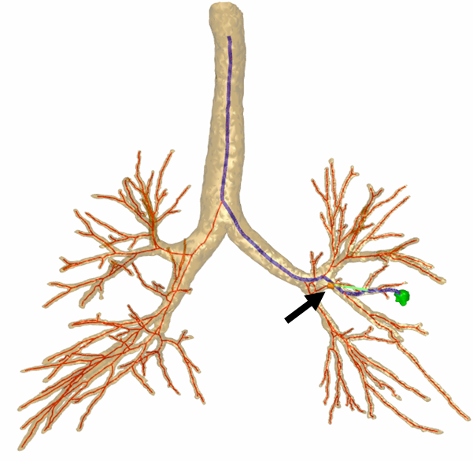
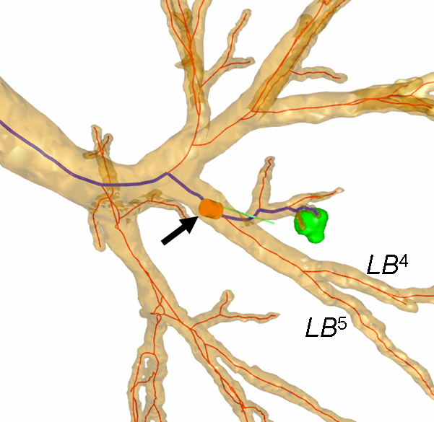
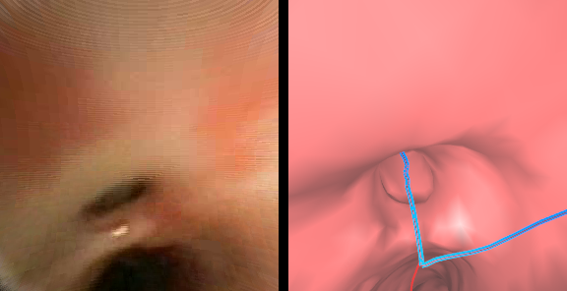
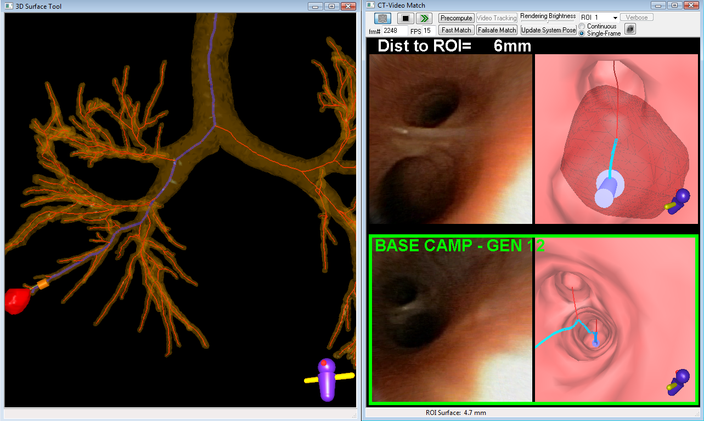
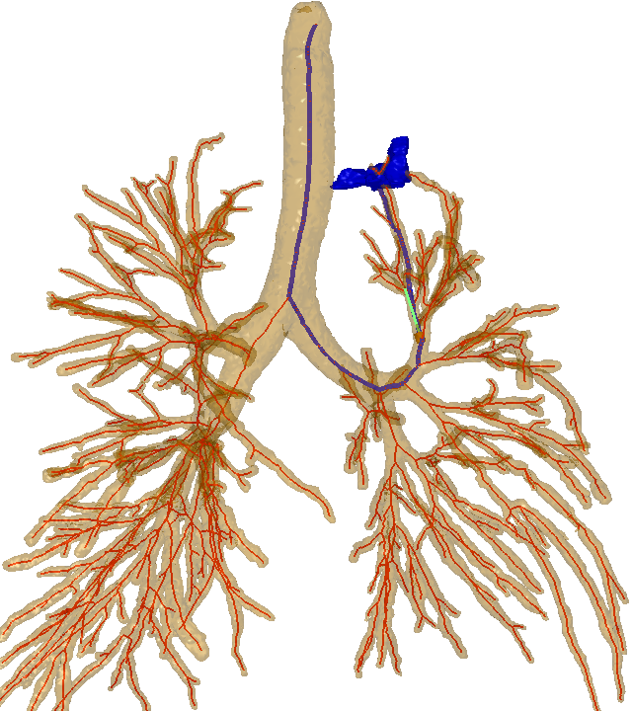
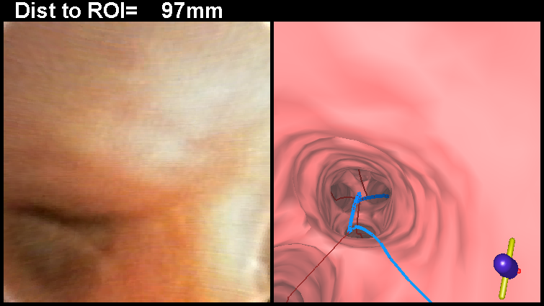
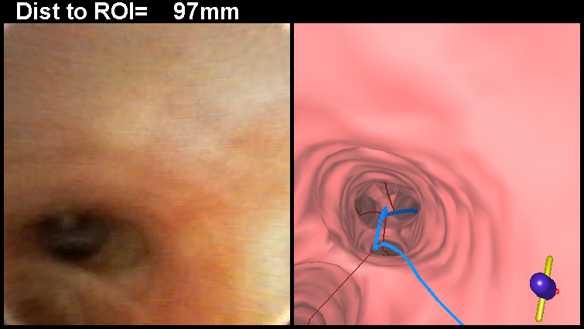
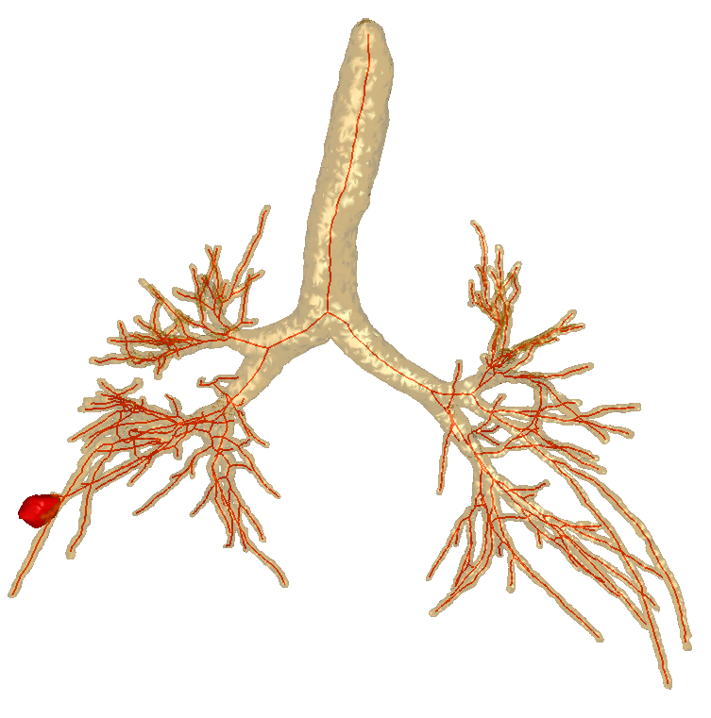
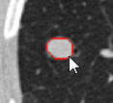
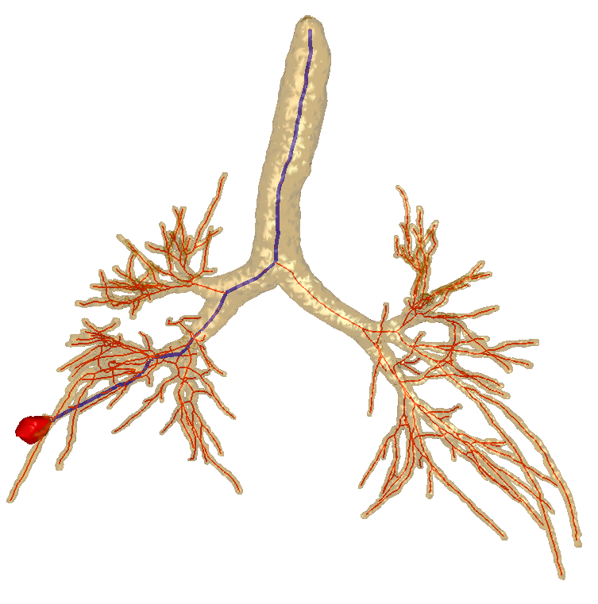
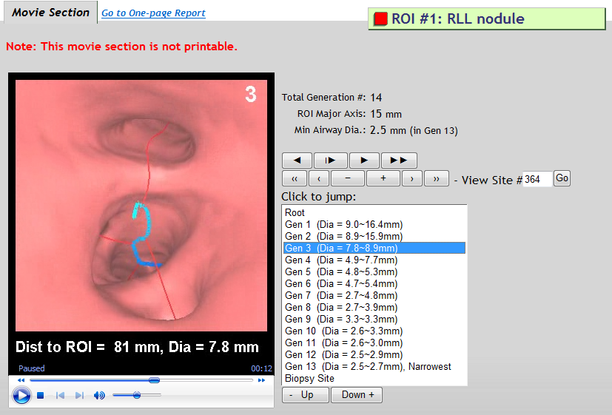
Experience with Image-Guided Ultrathin Bronchoscopy W.E. Higgins,¹ R. Bascom,² M.W. Graham,^{1,4} J.D. Gibbs,^{1,3} and D.C. Cornish¹ Penn State University, ¹College of Engineering, ²College of Medicine, ³Broncus Technologies, Inc., ⁴Google, Inc.
ATS 2010, New Orleans, LA
1. Background
Stage 2: Live image-based guidance for ultrathin bronchoscopy
In the bronchoscopy suite, the VNS computer was interfaced to the bronchoscope’s video output. We employed a 2.8-mm-diameter Olympus BF Type XP160F ultrathin videobronchoscope. Sampling procedures involved using either brushes or forceps. During the procedure, the bronchoscopist maneuvered the ultrathin bronchoscope along the predefined endobronchial route using the continuously-updated graphical information provided by the VNS computer (Figure 1). The computer also displayed unambiguous graphical information at the final biopsy site.
Reliable biopsy of peripheral nodules is important for lung cancer diagnosis. Ultrathin bronchoscopy offers a feasible means for peripheral lung-lesion biopsy. Recently, however, Virtual Bronchoscopic (VB) guidance derived solely from a patient’s multidetector CT (MDCT) chest scan has shown promise towards improving peripheral bronchoscopy performance.¹⁻³ We had previously shown that our computer-based virtual navigation system (VNS) provides reliable guidance and is feasible for human peripheral nodules.^{4,5} We now present the considerations that arise during procedure planning and follow-on guidance for ultrathin bronchoscopy.
3D route
(B)
3D route
Live video
Current VB view
(A)
2. Materials and Methods
(C)
Figure 2: Example of a difficult maneuver due to a sharp branching angle. (A) Global airway tree rendering, where blue line represents preplanned route, target nodule in green, and arrow indicates the location of the difficult turn. (B) A close-up view of the tree from (A). (C) A bronchoscopic video frame and corresponding VB rendering depicting the turn. The longest guidance time (32:07 min) in the study involved a nodule located 8 airway generations deep in the LUL (case 20349-3-25). The majority of the guidance time involved completing a single bronchoscope maneuver. The bronchoscopist had to insert the bronchoscope into a small orifice at an unusually sharp branching angle. As indicated by the blue line, the bronchoscopist must enter the top bronchus. The route was clear to the bronchoscopist, but the maneuver required many attempts.
We consented and enrolled 30 patients with focal lesions, suspected lung cancer and available MDCT scans. The chest scans, generated by either a Siemens Sensation or Emotion scanner, were reconstructed at a resolution of 0.5 mm spacing with 0.75-mm-thick two-dimensional axial-plane sections; axial-plane resolution was between 0.52 mm and 0.92 mm. We used the VNS for off-line procedure-planning and live image-based guidance for ultrathin bronchoscopy, as described below.³
Stage 1: Procedure planning
The bronchoscopist selected a region of interest (ROI) on a patient's three-dimensional (3D) MDCT chest scan. Next, VNS automatic methods defined the 3D tracheobronchial tree, endoluminal airway surfaces, and an optimal airway route for navigating the bronchoscope to the lesion. The bronchoscopist interactively previewed the procedure plan on the VNS computer to identify potential navigation difficulties and selected a tissue sampling technique.
Figure 3: Example of a difficult maneuver due to intermittent airway collapse. (A) Global airway tree rendering, where blue line is the preplanned route, target nodule in blue, and arrow indicates the location of the collapsed airway. (B) Video frame depicting the collapsed airway highlighted by a red ellipse side-by-side with the corresponding VB view. (C) Video frame depicting the opened airway highlighted by a green ellipse side-by-side with the corresponding VB view (case 20349-3-28).
Current position of bronchoscope tip
Target nodule
(B)
Frozen video
Frozen VB view
Figure 1: Computer display of the VNS captured during a live procedure (case 20349-3-24). The blue line is the route to the red target nodule. The line clearly and unambiguously leads the bronchoscopist to the target.
3. Results
(A)
The VNS fit smoothly into the clinical workflow, with required physician interaction limited to indicating target ROIs and previewing the image-guided procedure with the pre-bronchoscopy report. See ATS 2010 presentation (ref. 5) for complete study results. Below are highlights related to our experience with ultrathin bronchoscopy.
(C)
Target nodule
4. Conclusion
For ultrathin bronchoscopy to periphery, the VN system provides reliable guidance, but:
Use of small ultrathin bronchoscope needs skill and practice.
New sampling devices are needed for more effective tissue sampling.
Results:
45 target sites from 30 different cases considered for ultrathin bronchoscopy.
Excellent procedure planning: average navigation depth: 9.8 ± 2.2 airways.
Guidance successful for 40/45 (88%) sites navigated on average 8.0 ± 2.0 airways.
10 sites were situated in airway generation 10 or beyond.
Time to first sample: 6:48 ± 5:40 min (0:50 – 32:07 min).
19/45 (42%) of the target sites took less than 5:00 min.
36/45 (80%) of the target sites took less than 10:00 min.
A few outliers took considerable time; e.g., case 25 : 32:07 min, case 24 : 20:45 min.
The bronchoscopist indicates a target nodule (case 20349-3-24)
A patient-specific 3D airway model is automatically extracted from the MDCT data
References
F. Asano, Y. Matsuno, N. Shinagawa, K. Yamazaki, T. Suzuki, and H. Moriya. A virtual bronchoscopic navigation system for pulmonary peripheral lesions, Chest 130 (2) (2006) 559–566.
N. Shinagawa, K. Yamazaki, Y. Onodera, F. Asano, T. Ishida, H. Moriya, and M. Nishimura. Virtual bronchoscopic navigation system shortens the examination time—feasibility study of virtual bronchoscopic navigation system, Lung Cancer 56 (2) (2007) 201–206.
S. A. Merritt, J.D. Gibbs, K. Yu, V. Patel, L. Rai, D.C. Cornish, R. Bascom, and W.E. Higgins. Real-time image-guided bronchoscopy for peripheral lung lesions: A phantom study, Chest 134(5) (2008) 1017-1026.
M.W. Graham, J.D. Gibbs, K. Yu, D.C. Cornish, M.S. Khan, R. Bascom, and W.E. Higgins. Image-Guided Bronchoscopy for Peripheral Nodule Biopsy: A Human Feasibility Study, Am J Respir Crit Care Med 177 (abstracts issue) (2008) A893.
W. E. Higgins, R. Bascom, J. D. Gibbs, M. W. Graham, D. C. Cornish and R. Khare. Image-Guided Bronchoscopic Sampling of Peripheral Lesions: A Human Study, ATS 2010, page A5171.
Study challenges:
Some ultrathin bronchoscope maneuvers were difficult, needing multiple attempts to complete – independent of image-guided bronchoscopy (Figure 2).
Often the ultrathin bronchoscope could be guided but not navigated to the final destination because of small airway size.
Tissue sampling definitely difficult and limited.
Only a forceps and brush available for the Olympus BF Type XP160F bronchoscope.
Breathing-cycle-dependent collapse of airways made maneuver of the ultrathin bronchoscope difficult and thus led to increased guidance time (Figure 3).
An optimal 3D route to the ROI (blue line) is determined automatically
A pre-bronchoscopy report provides pictures of each bifurcation along the route and an interactive movie of the entire route to preview the procedure.
Acknowledgments
This work was funded by NIH NCI grants #CA074325 and CA091534.

